Slide 1
Foundation Earth and space sciences
Weather Watch
Weather images

Slide 2
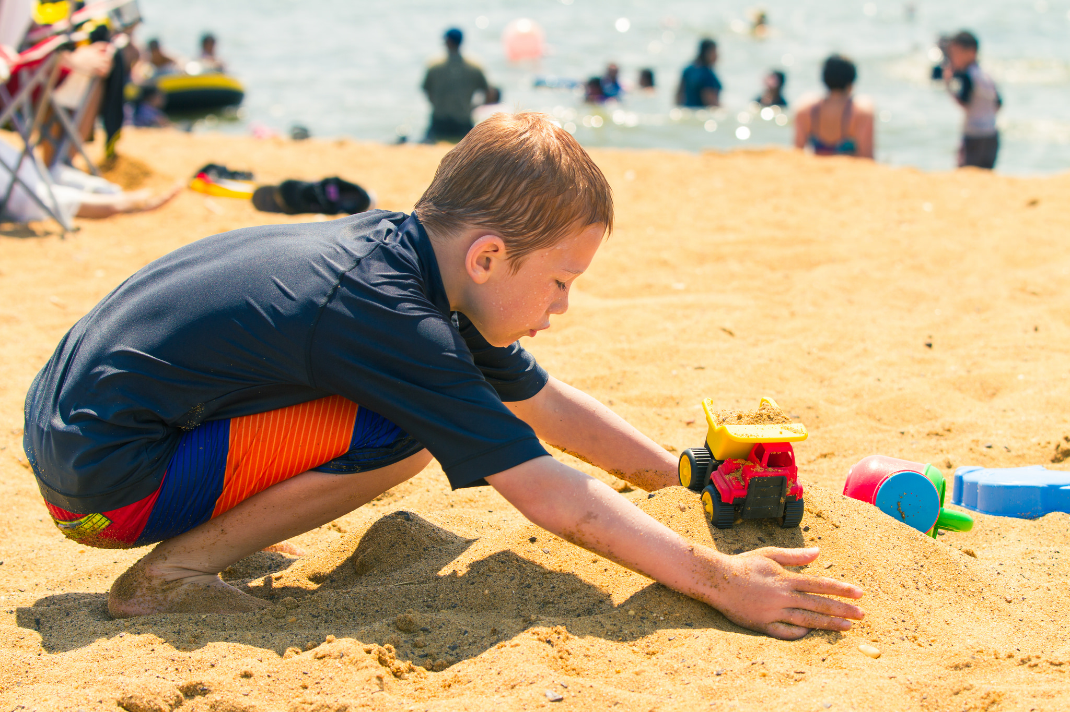
Playing trucks in the sand, Michael Bentley, CC BY 2.0

Slide 3
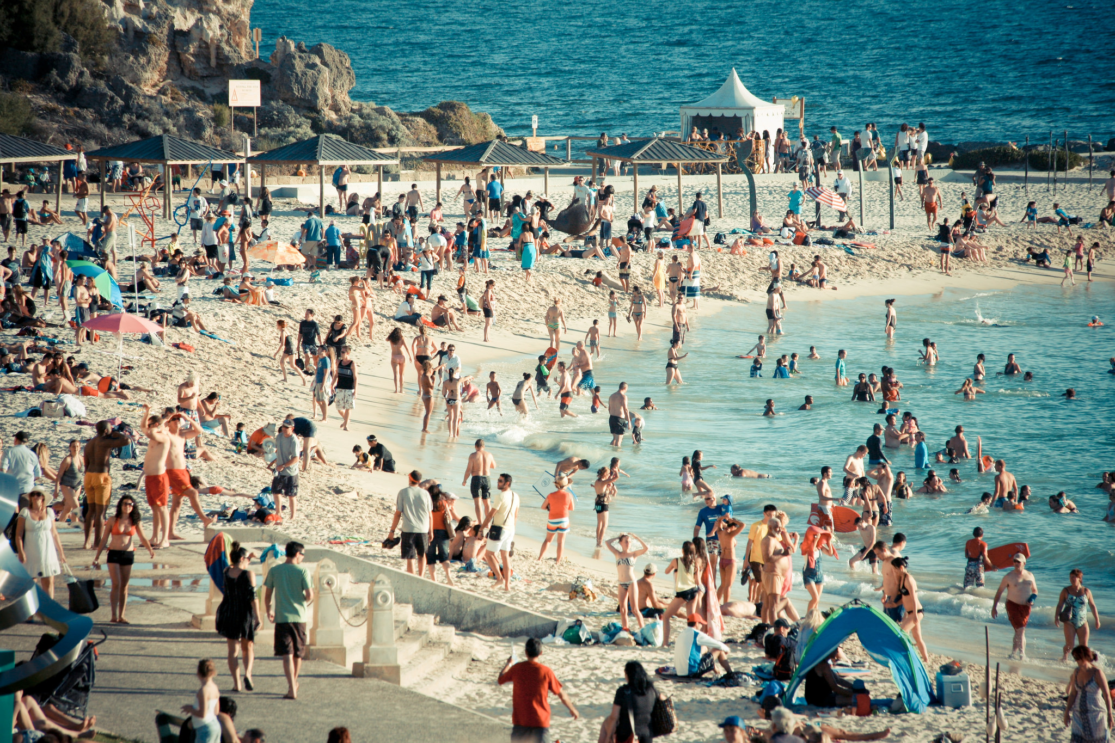
Cottesloe Beach, Perth, Matt Paish, CC BY 2.0

Slide 4
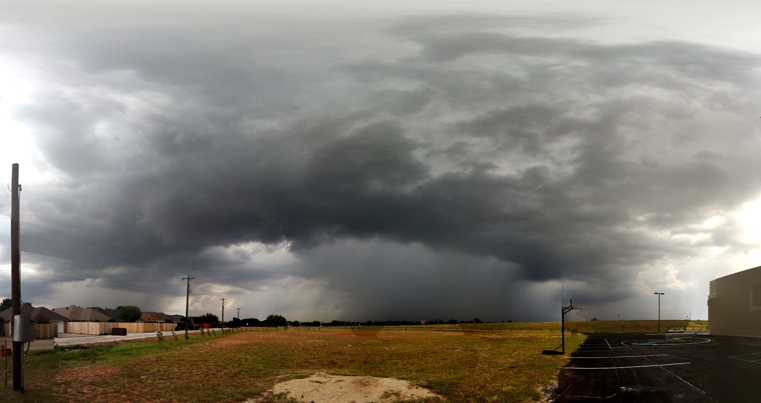
A quick pano…, Jason Hunter, CC BY 2.0

Slide 5
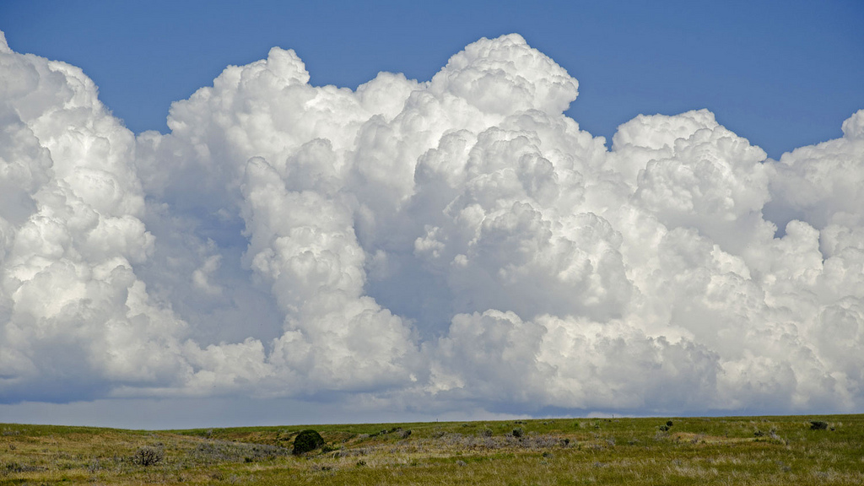
Clouds, Pattys-photos, CC BY 2.0

Slide 6
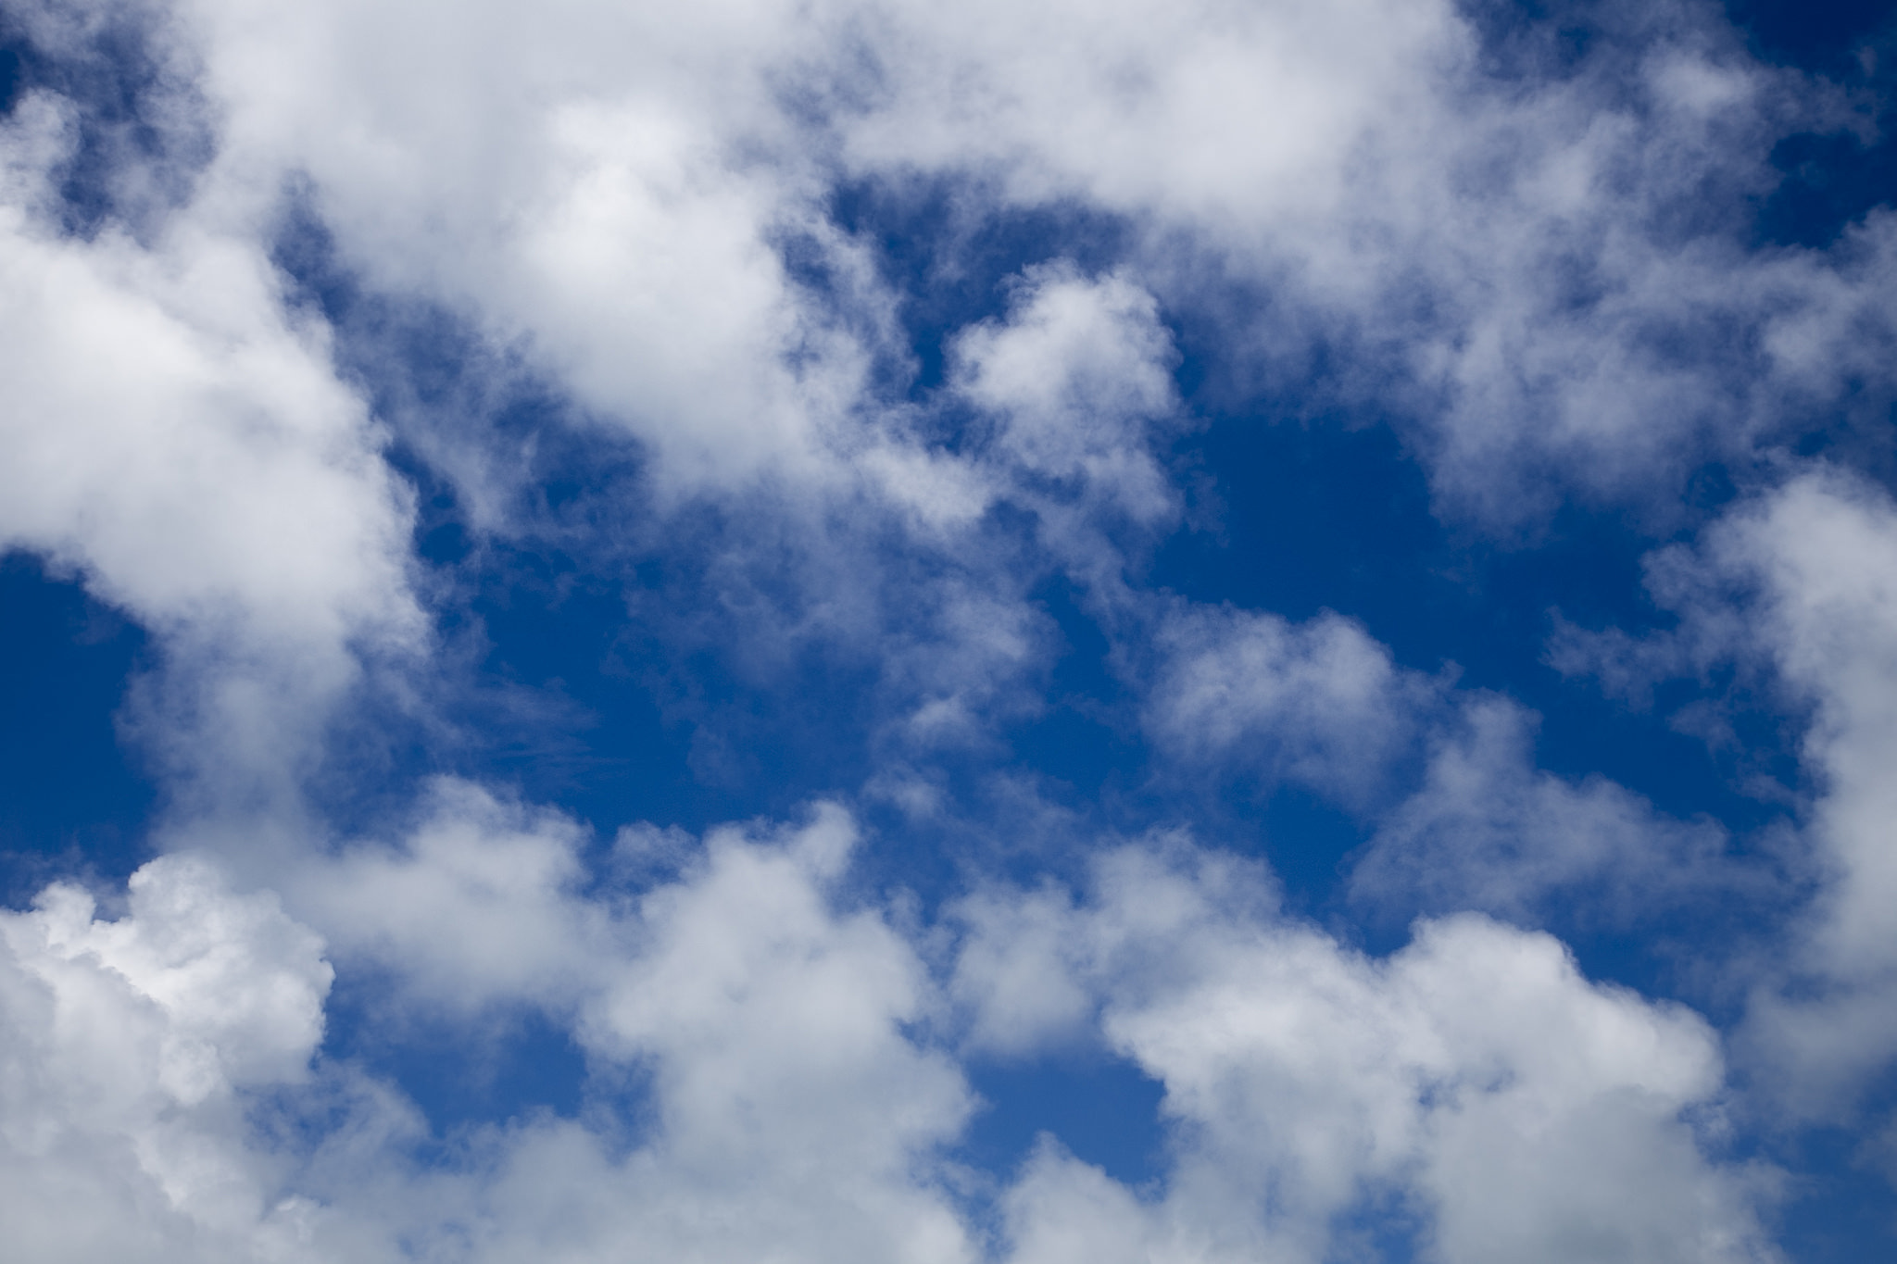
Clouds, actionvance, CC BY 2.0

Slide 7
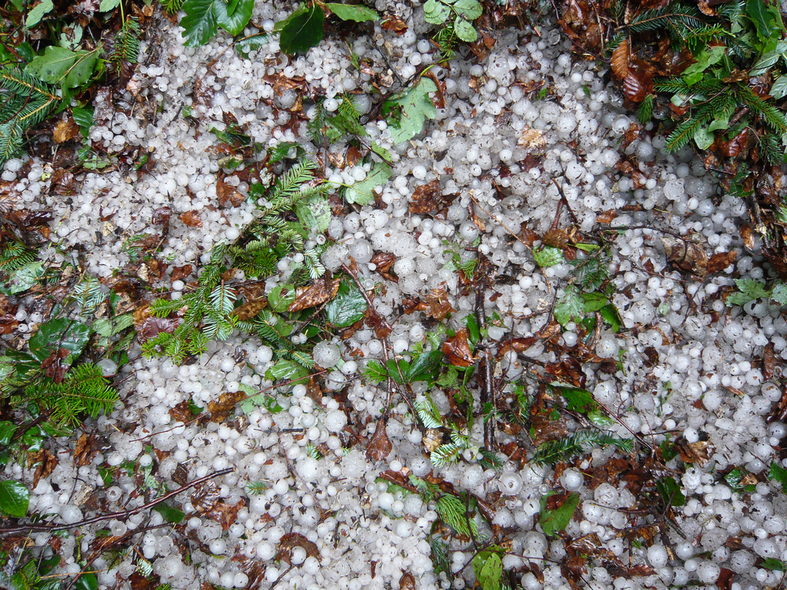
Hagelkörner Hailstone, Aah-Yeah, CC BY 2.0

Slide 8
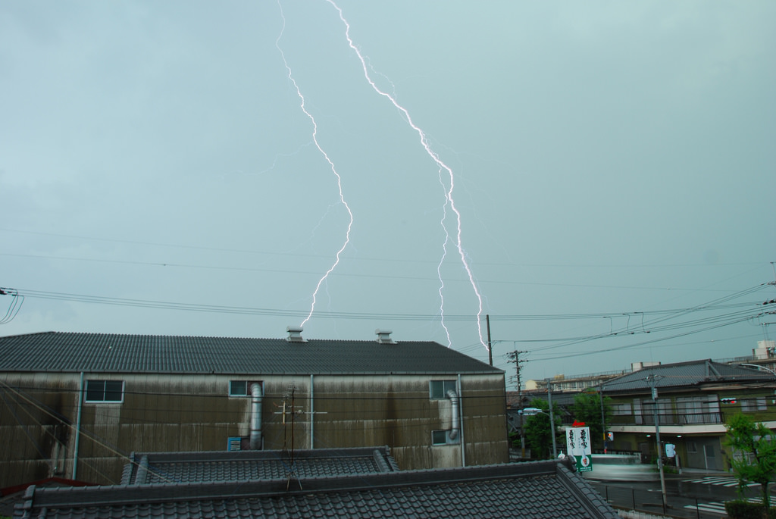
Lightening, gwaar, CC BY 2.0

Slide 9
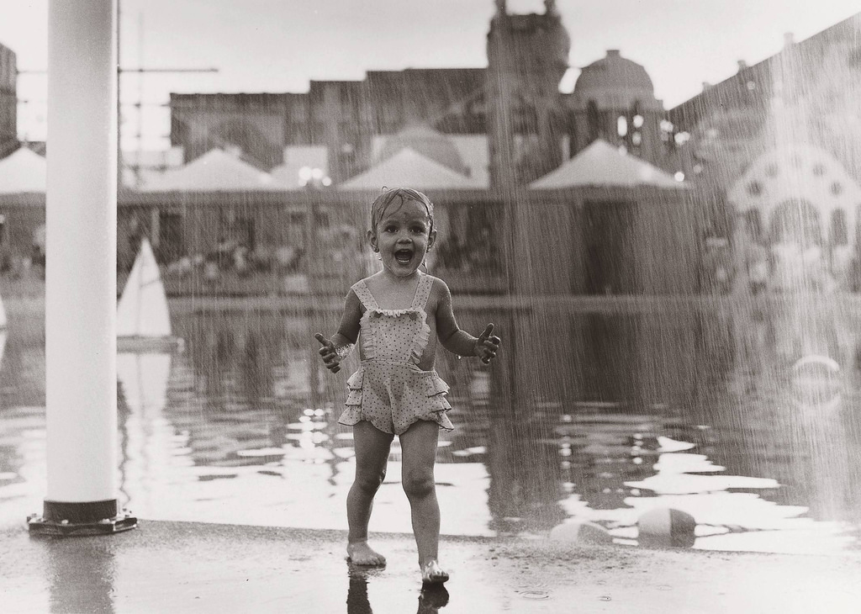
Rain Child, Christopher Porché, CC BY 2.0

Slide 10
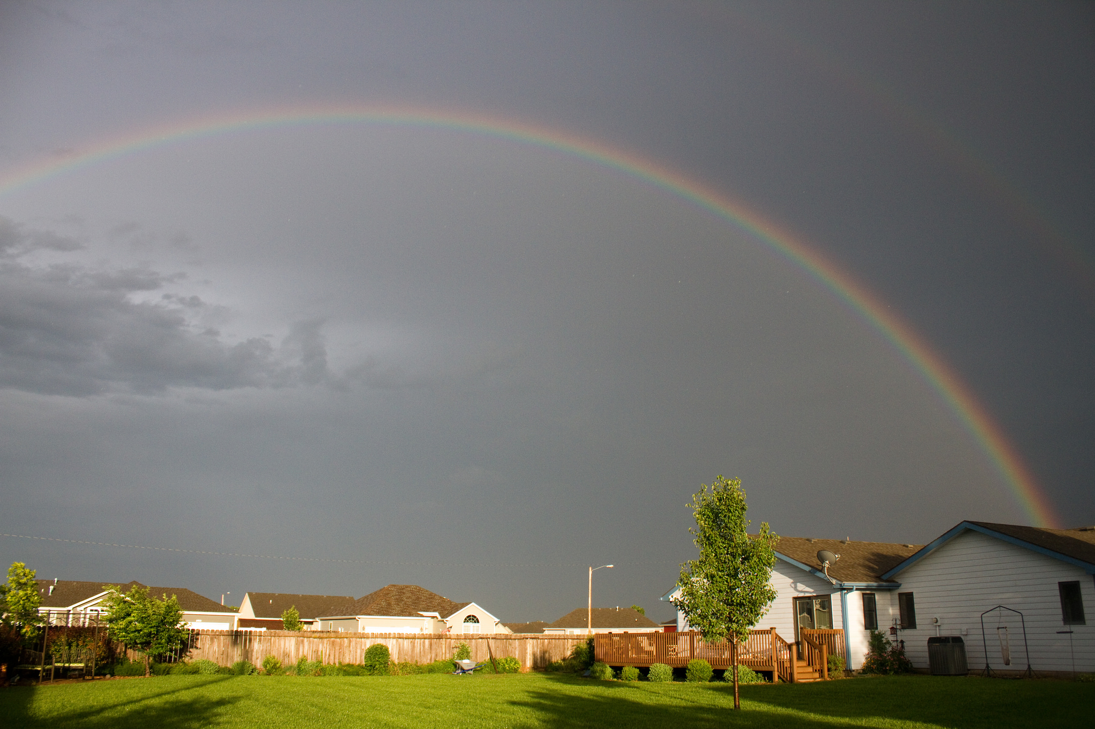
Double rainbow, One Day Closer, CC BY 2.0

Slide 11
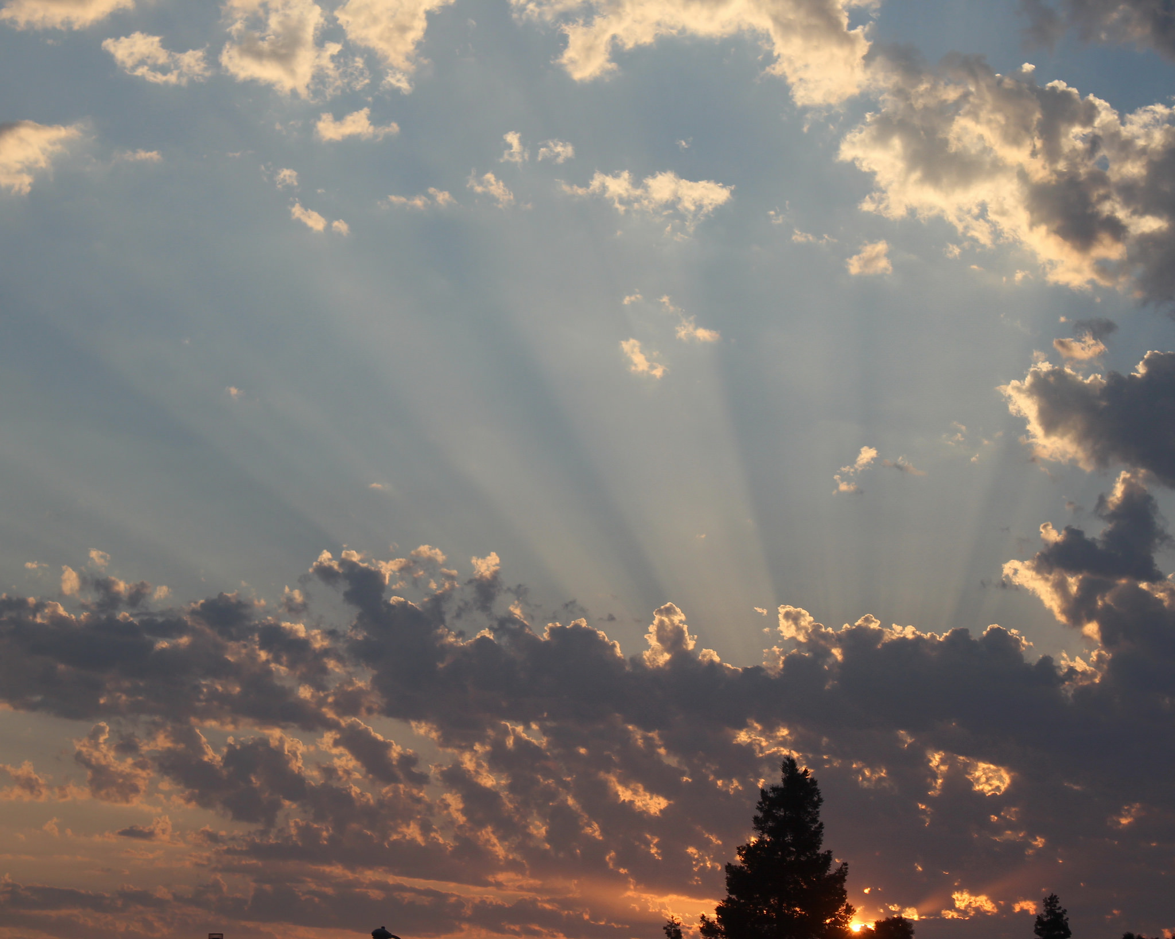
Sunrise, Jeffry, CC BY 2.0

Slide 12
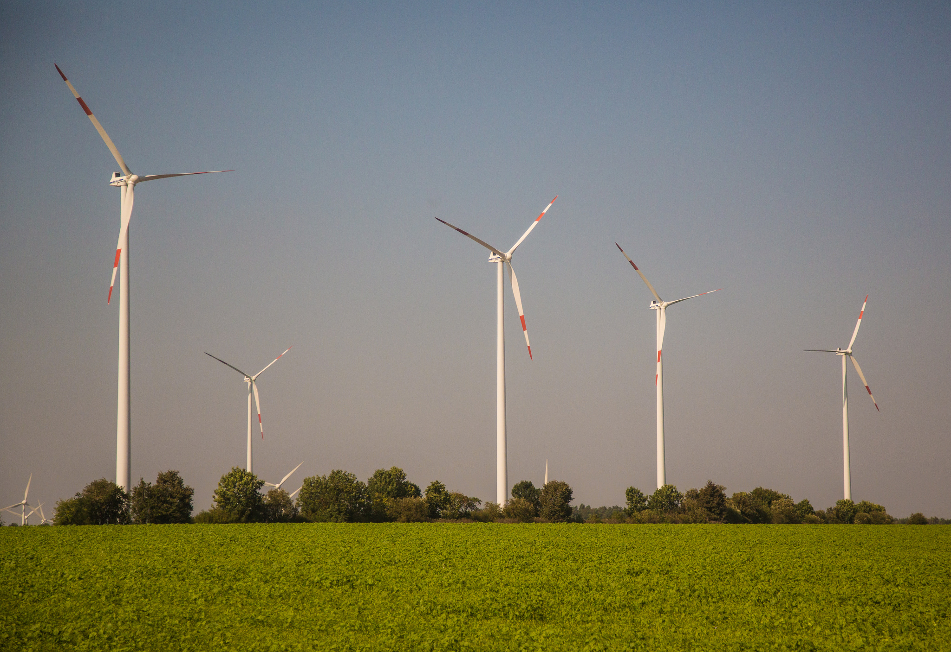
Germany Wind Turbines, Tony Webster, CC BY 2.0

Slide 13
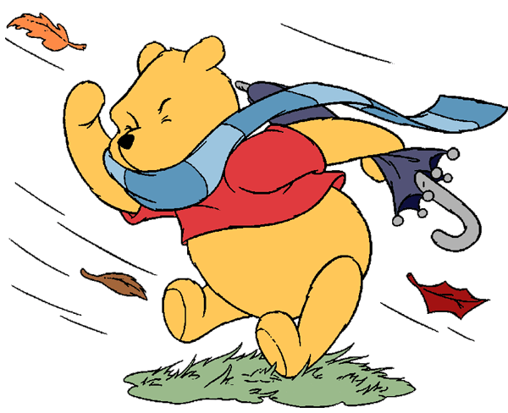
http://www.disneyclips.com/imagesnewb2/winniethepooh8.html

Slide 14
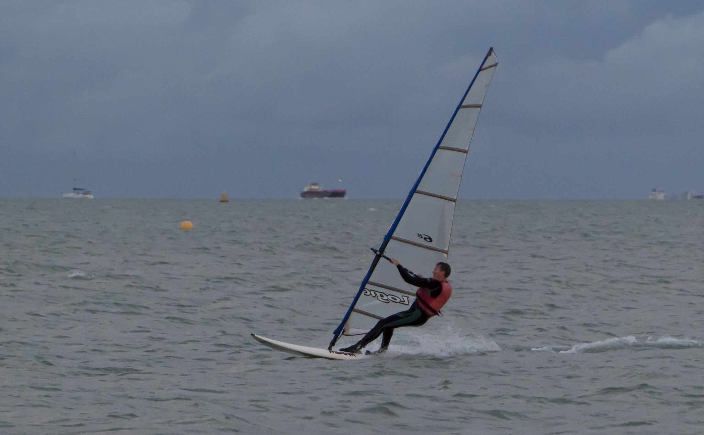
Wind surfer, Barry Skeates, CC BY 2.0

