Slide 1
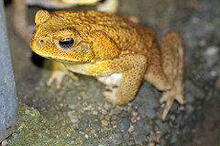
Why the cane toad was introduced
Cane toad
How the cane toad is affecting native plants and animals
(Bufo marinus)
Some interesting facts about the cane toad
How the cane toad could affect our food web
Control of the cane toad
Don’t forget to include a photo of your food web

Slide 2
Why the rabbit was introduced
European wild rabbit
How the rabbit is affecting native plants and animals
Some interesting facts about the rabbit
(Oryctolagus cuniculus )
How the rabbit could affect our food web
Control of the rabbit
Don’t forget to include a photo of your food web

Slide 3
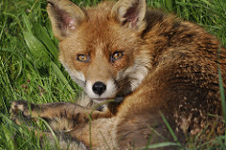
Why the fox was introduced
European red fox
How the fox is affecting native plants and animals
Some interesting facts about the fox
(Vulpes vulpes)
How the fox could affect our food web
Control of the fox
Don’t forget to include a photo of your food web

Slide 4
Why the cat was introduced
Feral cat
How the cat is affecting native plants and animals
Some interesting facts about the cat
(Felis catus)
How the cat could affect our food web
Control of the cat
Don’t forget to include a photo of your food web

Slide 5
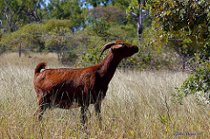
Why the goat was introduced
Feral goat
How the goat is affecting native plants and animals
Some interesting facts about the goat
(Capra hircus)
How the goat could affect our food web
Control of the goat
Don’t forget to include a photo of your food web

Slide 6
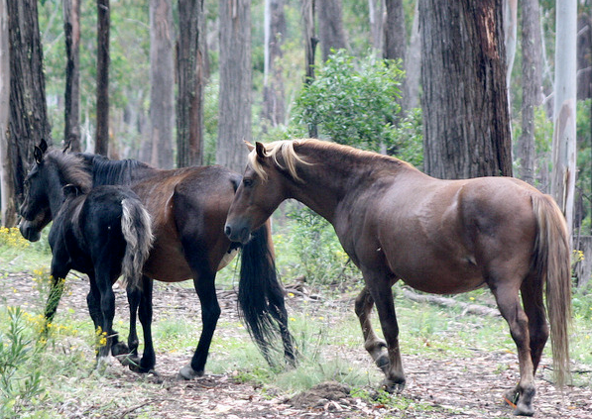
Why the horse was introduced
Feral horse
How the horse is affecting native plants and animals
Some interesting facts about the horse
(Equus caballus)
How the horse could affect our food web
Control of the horse
Don’t forget to include a photo of your food web

Slide 7
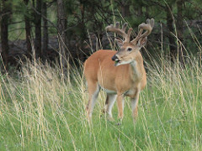
Why the deer was introduced
Feral deer
How the deer is affecting native plants and animals
Some interesting facts about deer
How the deer could affect our food web
Control of the deer
Don’t forget to include a photo of your food web

Slide 8
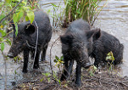
Why the pig was introduced
Feral pig
How the pig is affecting native plants and animals
(Sus scrofa)
Some interesting facts about the pig
How the pig could affect our food web
Control of the pig
Don’t forget to include a photo of your food web

