Slide 1
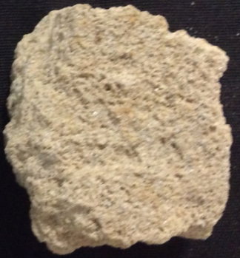
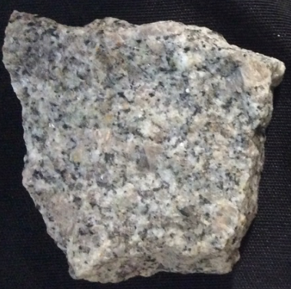
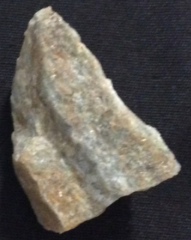
The rock cycle
Year 8 Earth and space sciences
The rock cycle

Slide 2
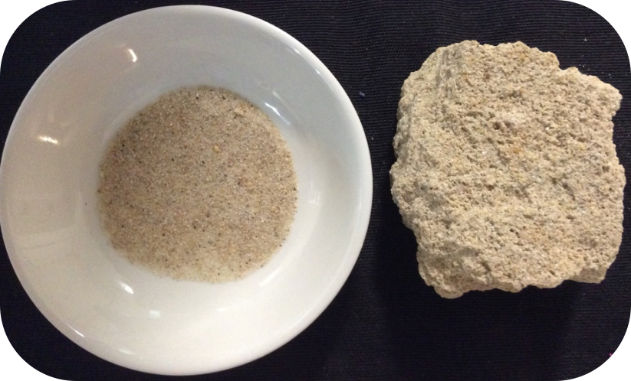
Think/Pair/Share
Question
How could you create sandstone out of sand?
sandstone
sand

Slide 3
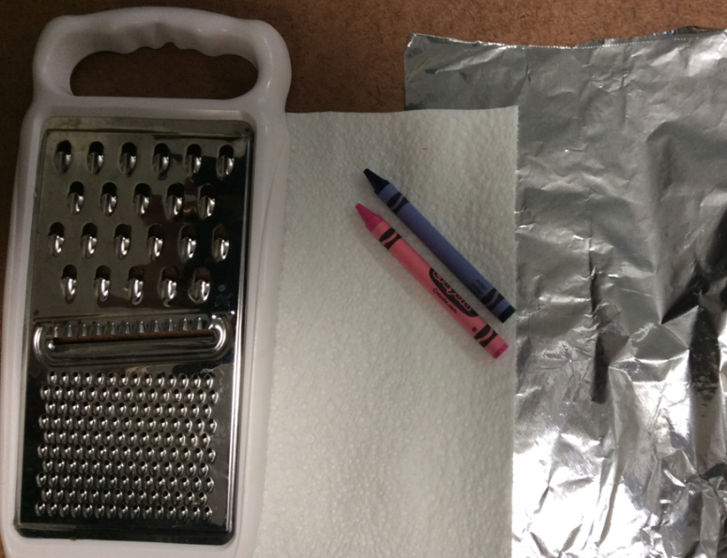
Investigation 1
Collect the following materials.
bench protector
two
crayons
aluminium
foil
grater
paper towel

Slide 4
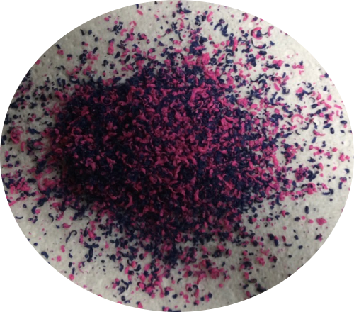
Grate the crayons onto the paper towel.
What process does this represent?
Weathering
Weathering is the breakdown of rocks at, or below, the Earth’s surface.

Slide 5
On your worksheet, write a description of how weathering occurred in your model.

Slide 6
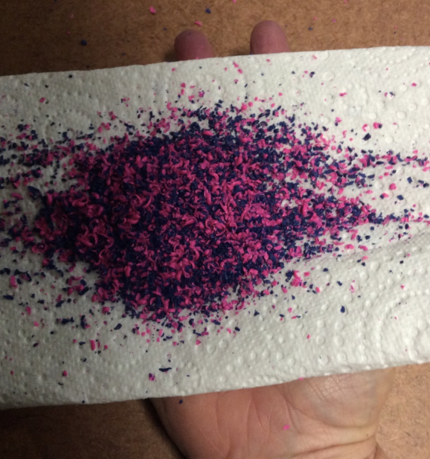
Pick up the grated crayons.
What process does this represent?
Erosion
Erosion is the movement of soil and rock material by agents such as water and wind.

Slide 7
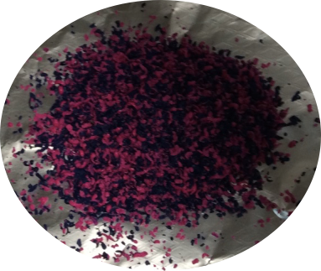
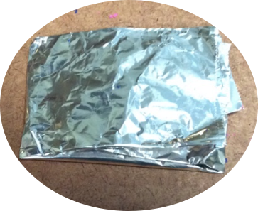
Drop crayon shavings onto aluminium foil and fold into a packet.
What process does this represent?
Deposition
Deposition is also known as sedimentation and it is the laying down of eroded sediment.

Slide 8
On your worksheet, write a description of how erosion and deposition occurred in your model.

Slide 9
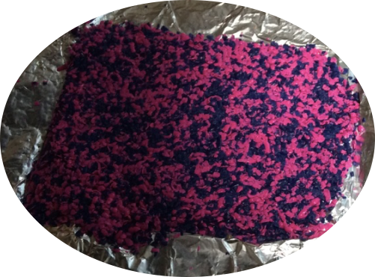
Put the packet between your hands and apply pressure.
You have now made a sedimentary rock.
Open the packet to observe your ‘rock’.

Slide 10
What process does this represent?
Compaction and cementation
Compaction occurs when deeply buried sediments are placed under pressure, squashing the grains together.
Cementation occurs when minerals from the water bind the grains together.

Slide 11
On your worksheet, write a description of how compaction and cementation occurred in your model.
Complete the worksheet.

Slide 12
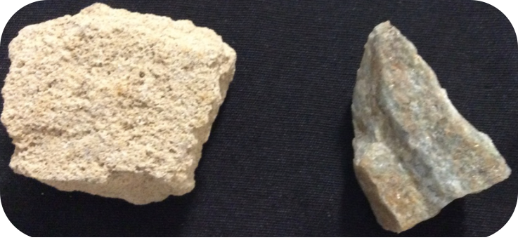
Think/Pair/Share
Question
How could you create quartzite out of sandstone?
sandstone
quartzite

Slide 13
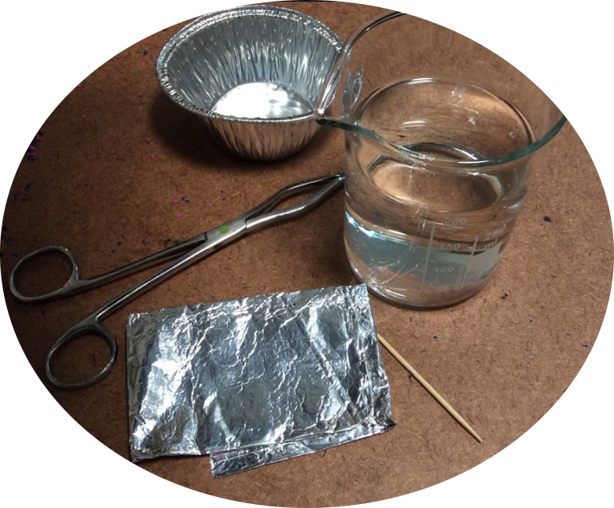
Investigation 2
Collect the following materials.
foil tray
beaker of
hot water
tongs
toothpick
crayon packet

Slide 14
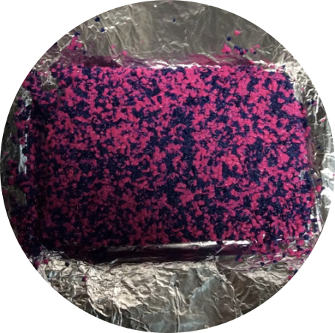
Rewrap your sedimentary crayon and place it under your foot and apply pressure.
What process does this represent?
Pressure
Pressure caused by being buried deep underground and from movements in the Earth’s crust.

Slide 15
On your worksheet, write a description of how pressure was applied in your model.

Slide 16
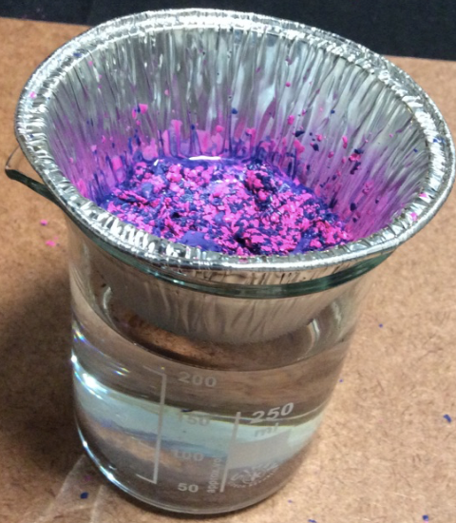
Place your rock in the foil tray.
Place the foil tray in the beaker of hot water.
Heat the crayon until it just starts to melt and is soft to touch. Both colours should still be visible.
Don’t use your finger, use the toothpick.
Allow to cool.

Slide 17
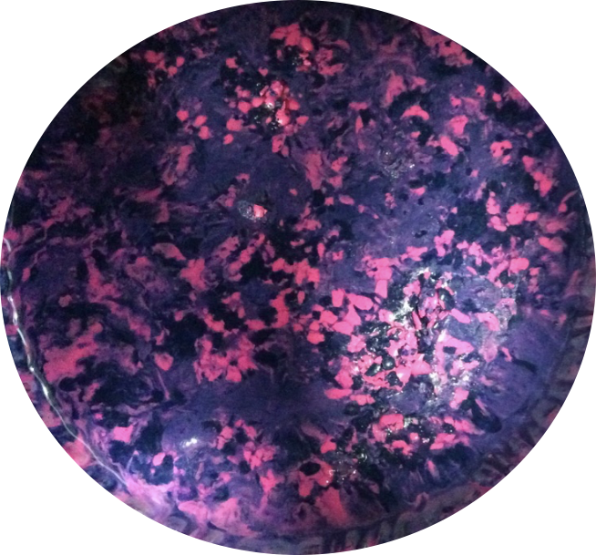
You have now made a metamorphic rock.

Slide 18
What process does this represent?
Heat
Rocks being subjected to high heat through the internal heat of the Earth and/or heat created by the pressure of overlying rock layers.

Slide 19
On your worksheet, write a description of how heat was applied in your model.

Slide 20
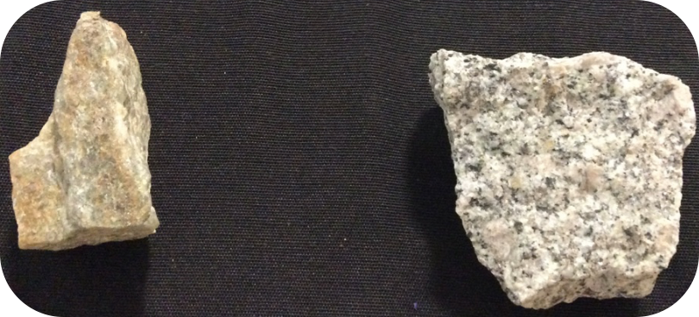
Think/Pair/Share
Question
How could you create granite out of quartzite?
quartzite
granite

Slide 21
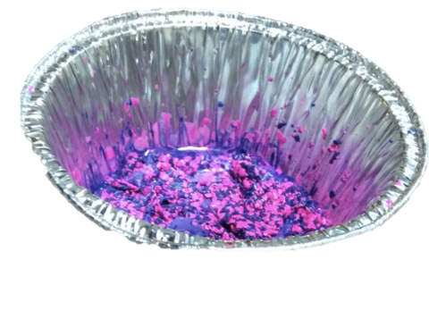
Investigation 3
Collect the following materials.
foil tray (with metamorphic rock)
beaker of
hot water
tongs
toothpick

Slide 22
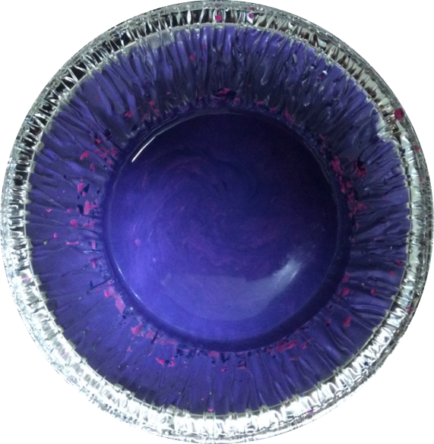
Melt ‘metamorphic rock’ until it is completely melted and the colours start mixing.
What process does this represent?
Melting
High temperatures are required to melt rocks. These temperatures are found deep within the Earth.

Slide 23
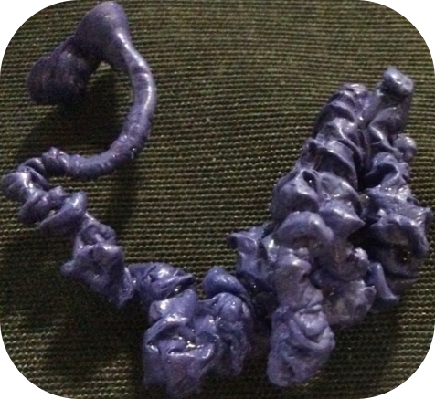
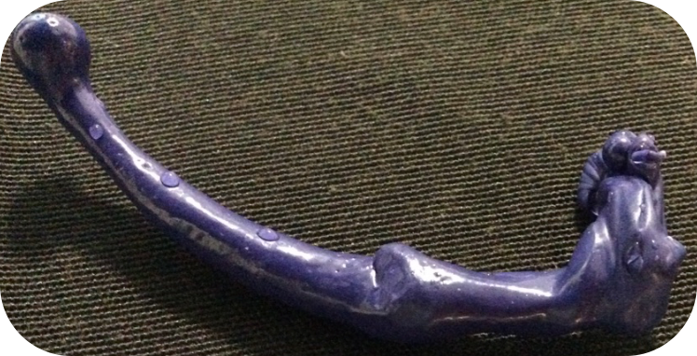
Cooling
The rate at which molten rock cools depends on the location of the molten rock. Molten rock could cool underground, on land or in water.
The size of the crystals in an igneous rock depends on the rate of cooling.

Slide 24
Select one of the methods below to cool your molten crayon.
Pour over ice cubes to form pumice.
    (cooling in water)
Pour into ice water to form obsidian.
  (cooling on land)
Pour over warm/hot water to form granite.
  (cooling underground)

Slide 25
On your worksheet, write a description of how you made an igneous rock in your model.

Slide 26
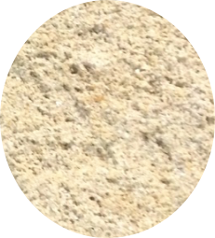
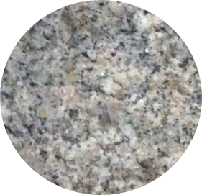
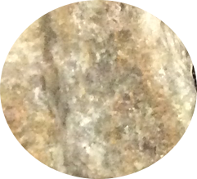
Sedimentary rock
A simple rock cycle
Weathering, erosion, compaction
and cementation
Burial at high temperature
and pressure
Crystallisation from magma
Weathering, erosion, compaction
and cementation
Crystallisation from magma
Burial at high temperature
and pressure
Igneous rock
Metamorphic rock

Slide 27
The rock cycle
Use the information you have gathered about rocks and the rock cycle to draw your own rock cycle.
Your rock cycle should contain the following:
The processes that occur to change the rocks from one type to another.
A description of each rock type.
Some examples of each rock type.
Notes:
Draw and label a diagram representing the rock cycle in the box. Describe the rock cycle on the lines below. Be sure to explain the processes required to change one type of rock into another.

